Slide 1
Video Library Management System
By,
TEAM 3
Abhi Shah(008424052)
Meet Mehta(008648939)
Snehal D’mello(008647639)
Sweta Patel(008671754)
Vidhi Shah(008141068)

Slide 2
Responsibility
Abhi Shah
Client GUI, client-side servlets, client-side validation, Database designing, Jmeter Performance measurement and server side validation.
Meet Mehta
Designing of web services and its Server side methods implementation, Database designing, Project Report and deployment on Google Cloud.
Snehal D'mello
Designing of web services and its Server side methods implementation, Database designing and Project Report.
Sweta Patel
Designing of web services and its Server side methods implementation, Connection Pooling, Database designing and Project Report.
Vidhi Shah
Client GUI, client-side servlets, Junit testing and Project Report.

Slide 3
Performance
Connection Pooling
INNODB over MYISAM engine in MySQL
Caching
Database Tuning
Using Full column names instead of *
Using PreparedStatement over Statement
Avoid LIKE in query

Slide 4
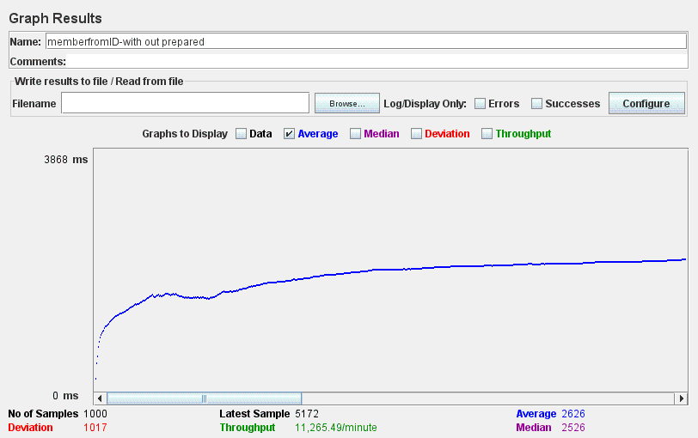
Base Class

Slide 5
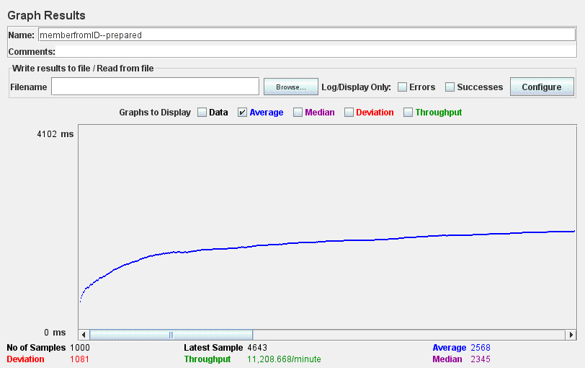
With Prepared Statement

Slide 6
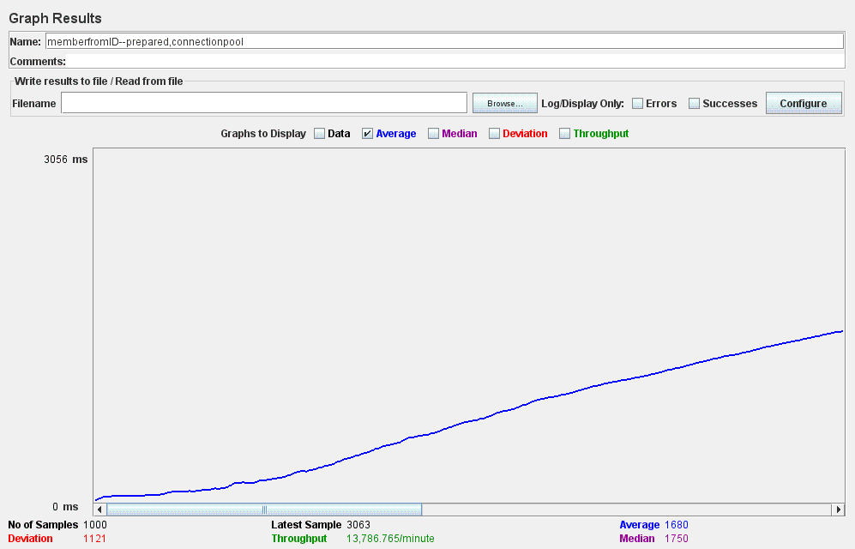
With Connection Pooling

Slide 7
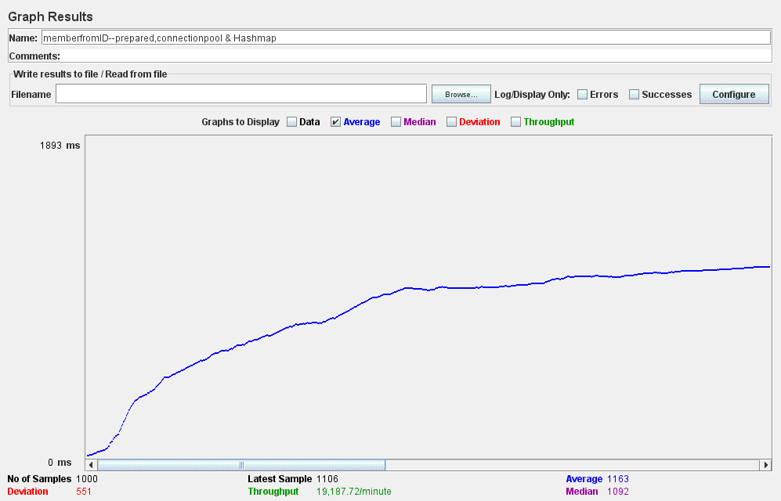
With Pooling and Caching

Slide 8
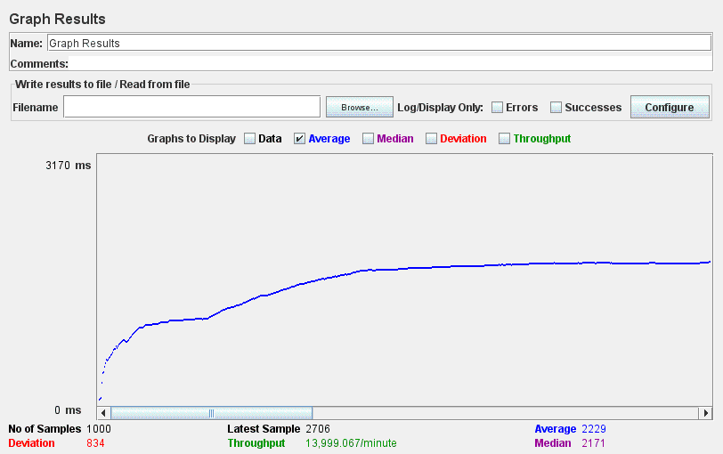
Display Movies Without Pooling

Slide 9
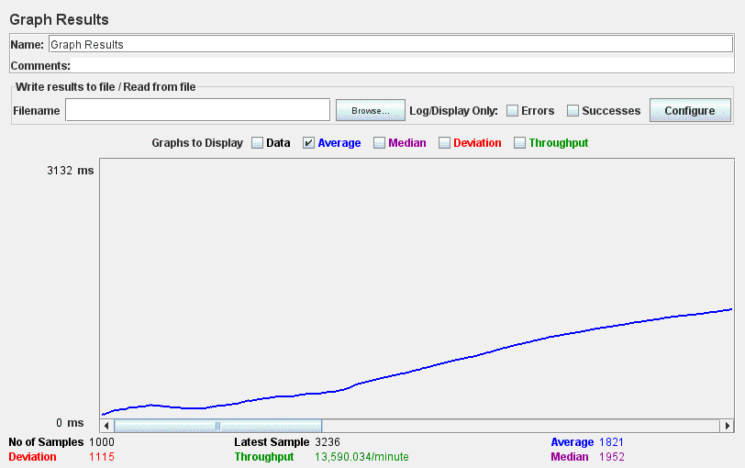
Display Movies With Pooling

Slide 10
Comparison

Slide 11
Extra
Deployed few pages on Google app engine.
http://videosystem273.appspot.com/

Slide 12
Thank You

